Slide 1
Dementia
Clearing up The Confusion
Tammy L. Soukup, BSN, RN
Alverno College MSN Student
May 2010

Slide 2
Dementia – Clearing Up the Confusion
DEMENTIA
THE BRAIN
DISEASES
ALZHEIMERS DISEASE
OTHER FACTORS
  Aging
  Genetics
  Stress
  Inflammation
  NURSING IMPLICATIONS
  CASE STUDY
At the end of this tutorial the learner will be able to:
  Discuss dementia and the pathophysiology related to it.
  Discuss other factors that impact dementia.
  Discuss nursing implications while caring for patients with dementia.
Directions: Click on topics on the left to link to information.
From there:
To go to next slide, click
To go to Home page, click

Slide 3
What is Dementia?
Dementia is defined as the development of multiple cognitive deficits that include memory impairment and at least one of the following cognitive disturbances:
  Aphasia, which is a decreased language function.
  Agnosia, where a person can’t recognize everyday objects.
  Apraxia, when a person has a decreased ability to perform motor abilities.
American Psychiatric Association. (2000)

Slide 4
To Be Considered Dementia:
The cognitive deficits involved must cause a problem in occupational or social functioning.
The patient’s behavior must be a decline from a previously higher level of functioning.
A required behavior to make the diagnosis is memory impairment.
American Psychiatric Association. (2000).

Slide 5
Dementia is not Delirium
In contrast to dementia, delirium is a “disturbance of consciousness that is accompanied by a change in a person’s cognition that can’t be accounted for by a preexisting or evolving dementia”.
  Patients with delirium
    Lack awareness of the environment
    Are incapable of shifting attention or focus
    Have behavior that fluctuates
American Psychiatric Association. (2000).

Slide 6
Dementia is not Depression
Depression:
Is a subjective feeling of sadness or emptiness.
Persons with depression can have
  diminished interests or pleasures in all activities,
  weight changes,
  insomnia,
  agitation,
  diminished ability to concentrate,
  suicidal ideation
Depression manifests with symptoms of impaired social and occupational areas of functioning.
American Psychiatric Association. (2000).

Slide 7
Contrasting the 3Ds
Dementia, Delirium, Depression
They are not the same.
Dementia | Delirium | Depression
Gradual cognitive decline Normal alertness until end stages Irreversible Impairment in social and occupational areas of functioning Normal attention span until late stages | Abrupt onset of decline Disturbance of consciousness Reversible Change on cognition that can not be accounted for by a preexisting medical condition Reduced level of consciousness Often occurs at night | Abrupt onset of decline Reversible Impairment in social, occupational areas of functioning. Diminished interest in pleasure in all activities Inability to think or concentrate
American Psychiatric Association. (2000).

Slide 8
Memory Jogger
Answer True or False
A required behavior to make the diagnosis of dementia is memory impairment.
Dementia involves at least one of the following cognitive disturbances:
  Aphasia
  Agnosia
  Apraxia
true
false
true
false

Slide 9
A brief comparison of the different types of dementia
Cortical Dementia | Sub-Cortical Dementia | Progressive Dementia | Primary Dementia | Secondary Dementia
Affects the cerebral cortex where memory and language are processed. | Affects parts of the brain involved with emotions and movement . | Gets worse over time. Interferes more and more with cognitive abilities . | Alzheimer’s disease that does not result from any other disease. | Related to a physical disease or injury.
Alzheimer's Association. (2010).

Slide 10
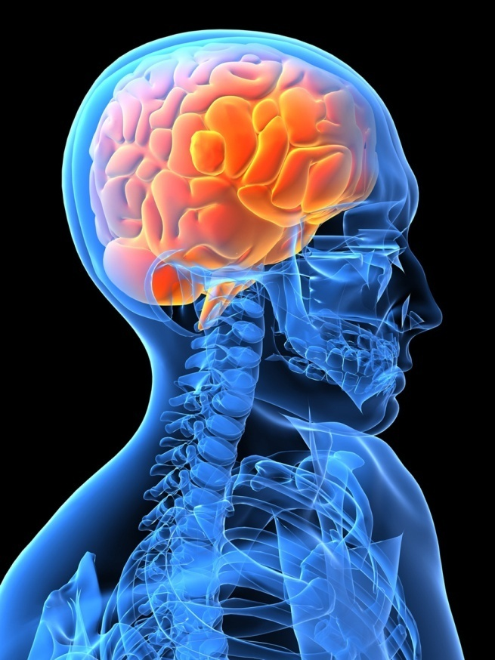
The Brain is the Body’s Control Center
Sensory information is processed in the brain.
The brain is about the size of a medium cauliflower yet it regulates conscious thought and mental activity.
We have about 100 billion neurons at birth.
There are about 100 trillion synapses between neurons in the brain.
Alzheimer's Association (2010)

Slide 11
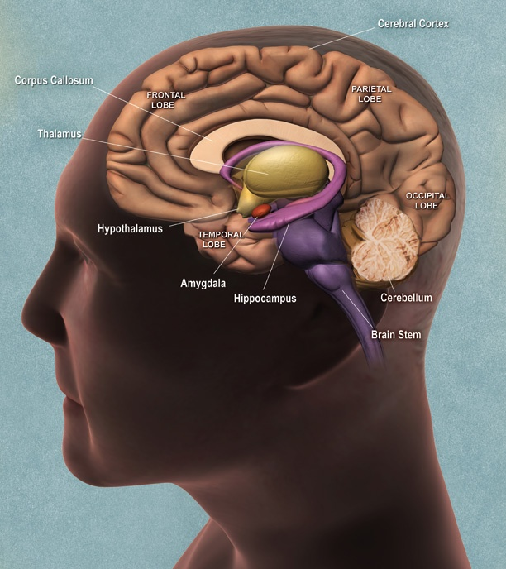
Parts of the Brain Include:
The cerebellum which can be called the “little brain”.
The cerebral cortex which controls movement.
The brain stem which controls alertness.
The Hypothalamus which controls homeostasis.
The Hippocampus which controls short term memory.
Porth, C. M., & Matfin, G. (2009)
National Institute on Aging. (2010)

Slide 12
There are 4 Lobes in the Brain
The Frontal Lobe
  For abstract thinking and judgment
The Temporal Lobe
  For memory and visual associations
The Parietal Lobe
  For recognizing pain and temperature, pressure
The Occipital Lobe
  For vision
Porth, C. M., & Matfin, G. (2009 )
National Institute on Aging. (2010)

Slide 13
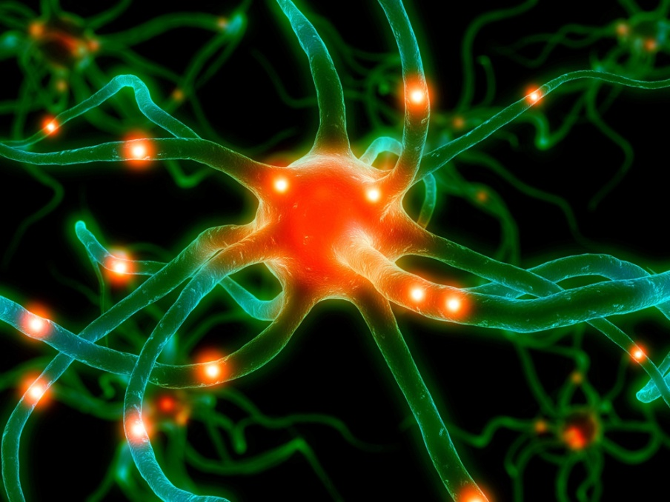
Neurons
The brain has billions of neurons at birth.
Each Neuron has an axon and many dendrites.
Neurons communicate with each other, carry out metabolism, and repair themselves.
Porth, C. M., & Matfin, G. (2009 )

Slide 14
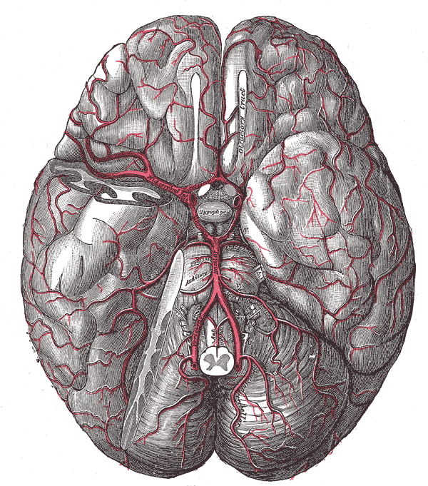
Blood Supply to the Brain
Cerebral or brain tissue requires a constant and adequate supply of nutrients.
  The brain receives about 20% of cardiac output
  The circulatory system to an in the brain is intricate and includes:
    The carotid system
    The Circle of Willis
    The venous system
Porth, C. M., & Matfin, G. (2009 )
www.wikipedia.org

Slide 15
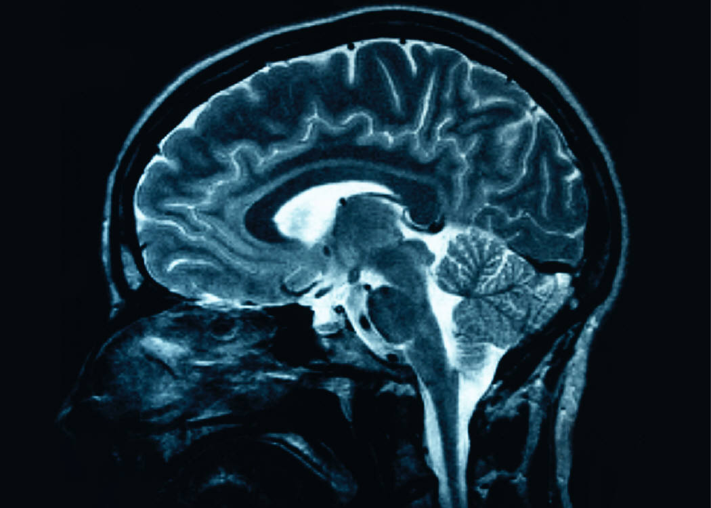
Diseases of the Brain
When cells and neurons die within the brain diseases can occur.
Some diseases manifest themselves in the form of dementia.
Kohlman, V. C., Lindsey, A. M., & West, C. M. (2003).

Slide 16

Diseases Associated with Dementia
Vascular Dementia
  The second most common cause of dementia is vascular related, mostly caused by cerebral vascular disease.
Lewy Body Dementia
  About 10% of all demented patients over the age of 70 have Lewy Body Dementia.
Alzheimer's
  The most common cause of dementia in the elderly is Alzheimer's. It accounts for 70-80% of dementia cases.
Alzheimer's Association (2010)

Slide 17
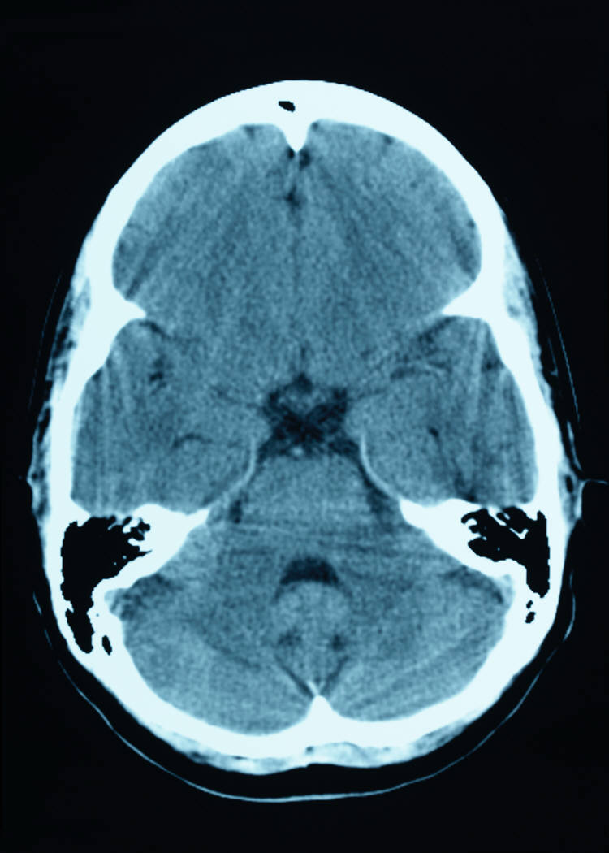
Vascular Dementia
Is associated with syndromes of brain damage such as:
  Ischemic injury
  Anoxia or hypoxic brain damage
Risk factors for vascular dementia include :
  Hypertension
  Diabetes
  Hyperlipidemia
  Smoking
  Cardiac arrhythmias
Patients with vascular dementia often have stroke like episodes.
Querfurth, H. W., & Lafera, F. M. (2010).

Slide 18
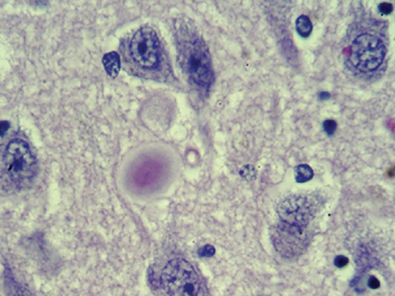
Lewy Body Dementia
Lewy Bodies are proteins which are not normally present in the brain.
They contain Alpha Synuclein a 140 AA protein which then causes neuron loss and gliosis or brain scarring.
Lewy Bodies were formerly thought to only occur in patients with Parkinson’s disease, but this is not true.
Graphic from www.genome.gov
Querfurth, H. W., & Lafera, F. M. (2010).

Slide 19
Lewy Body Disease
The onset of Lewy Body Disease occurs typically between ages 50-70.
In this disease the depletion of acetylcholine (a neurotransmitter) can be more severe than in Alzheimer’s .
Treatment for this includes giving cholinesterase inhibitors.
Alzheimer's Association. (2010)

Slide 20

Alzheimer's Disease
The exact cause of Alzheimer’s is unknown.
Statistics show that:
  1 in 8 men and 1 in 4 women will develop Alzheimer’s disease during their lifetime.
  More than 4.5 million people suffer from Alzheimer’s disease in the United States.
  By the year 2050 the number of people affected by this disease will exceed 13 million.
Alzheimer's Association. (2010)

Slide 21

Alzheimer's Disease
Alzheimer's comprises 70-80 % of dementia; but we don’t want to disregard the Vascular or Lewy Body Diseases.
Nursing interventions for these patients are often similar, even though the causes and medical treatments may differ.

Slide 22
Memory Jogger
Answer True or False
Alzheimer's accounts for 70-80% of dementia.
Three causes for dementia can be Alzheimer's, Lewy Body Disease, and Vascular Diseases.
true
false
true
false

Slide 23
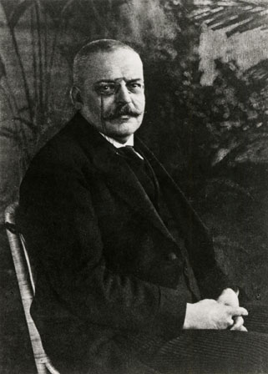
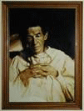
Alzheimer's Disease
Alzheimer’s disease is named after Dr. Alois Alzheimer.
In the early 1900’s he noticed a patient named Auguste, had symptoms of memory loss, language problems, and unpredictable behavior. After she died at age 56, he examined her brain.
Alzheimer's Association. (2010)
Alzheimer's Association. (2010)
www.wikipedia.org

Slide 24

Three major components of Alzheimer's are:
  Amyloid Plaques
  Tau Protein
  Neurofibrillary Tangles
  Very much like the intricacies of the railroad system the brain works to keep us on track. When the Plaques, Taus, and Tangles go awry the system gets off track and leads to:
    Neuron degeneration
    Reduced transmitter abilities
    Changes to the brain which occur long before the onset of the disease
Kohlman, V. C., Lindsey, A. M., & West, C. M. (2003)

Slide 25

Plaques
Plaques are formed when beta- amyloid proteins, normally a soluble substance, becomes insoluble.
Plaques produce neurofibrillary tangles.
Senile plaques are what lie across the cell membrane.
Plaques are filled these amyloid proteins that accumulate outside the brains nerve cells.
Alzheimer's Association. (2010)

Slide 26

Beta- Amyloid Plaques
Amyloid precursor protein (APP) is the precursor to amyloid plaque.
It is a protein that aids in the growth and maintenance of the neuron.
Certain enzyme(secretases) cut the APP into fragments of beta amyloid that drift from the cell membrane.
Amyloid plaque disrupts normal neuron functioning by triggering inflammation.
Alzheimer's Association. (2010)

Slide 27

Tau Proteins
Tau is a protein that help the axon of healthy neurons.
Acts as a bridge and stabilizes the neuron structure.
Tau protein and microtubules work together to act as a railroad track or conduit.
In Alzheimer's disease Tau proteins get tangled up with each other because they are very sticky.
The microtubules begin to collapse and the Tau proteins bind together forming Neurofibrillary Tangles.
Alzheimer's Association. (2010)

Slide 28

Tangles
  In Alzheimer patients, the brain cell microtubules unravel and develop into neurofibrillary tangles.
  Neurofibrillary tangles make a mess in the brain, and eventually cause neuron’s to die.
  Much like the train trying to get to its destination, brain neurons can’t communicate.
Alzheimer's Association. (2010)

Slide 29
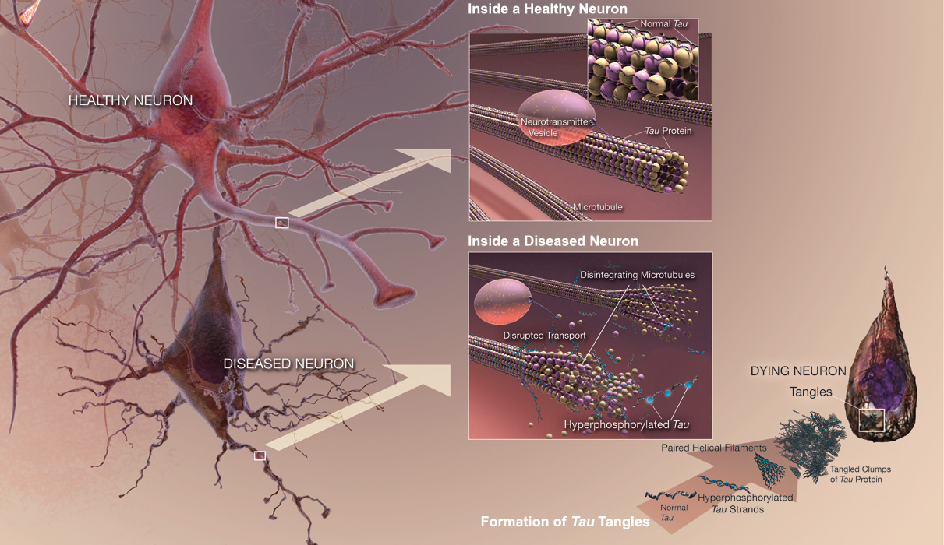
A healthy neuron compared to a diseased neuron.
Alzheimer's Association. (2010)

Slide 30

The role of Acetylcholine in Alzheimer’s Disease
Acetylcholine is the major neurotransmitter involved in memory and learning.
The loss of Acetylcholine or “cholinergic transmission” to the cortex of the brain may be responsible for the cognitive deficits.
Querfurth, H. W., & Lafera, F. M. (2010).

Slide 31
The Role of Acetylcholine in Alzheimer’s Disease
Alzheimer’s disease affects specific areas of the brain, especially the cholinergic neurons.
There is a lower level of activity of choline acetyltransferase in the cerebral cortex of patients with Alzheimer's disease.
Querfurth, H. W., & Lafera, F. M. (2010)

Slide 32
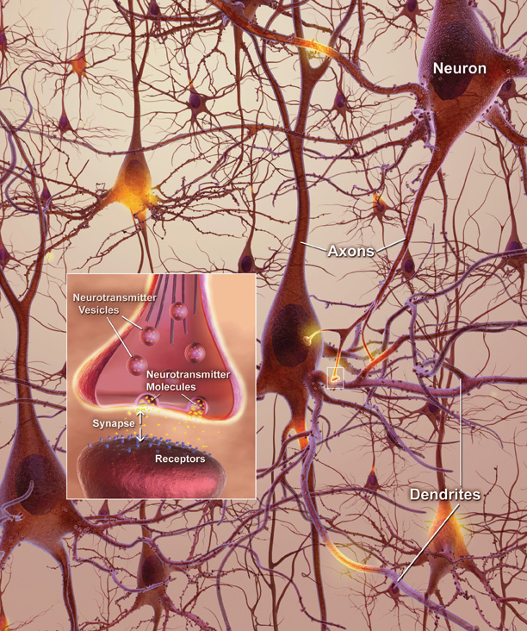
How neurons look when disease takes over.
National Institute on Aging. (2010)

Slide 33
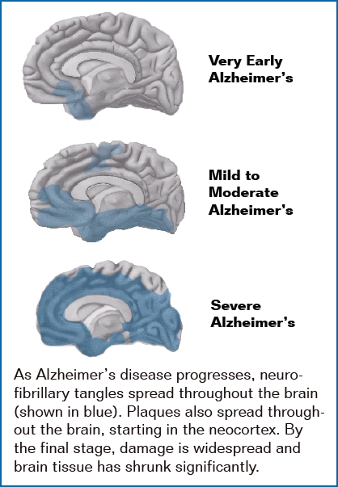
National Institute on Aging. (2010)

Slide 34

Signs of Dementia Include:
Loss of cognitive function
Wandering
Confusion
Forgetfulness
Inattention to personal care
Mood swings
Anxiety
Fearfulness
Difficulty problem solving
Poor concentration
Alzheimer's Association. (2010)

Slide 35

Aging
Aging leads to low levels of antioxidant defenses and an increased production of oxygen derived radicals.
Antioxidants help to neutralize “free radicals” and slow process of aging.
Brain aging creates an imbalance between neuronal injury and repair.
Querfurth, H. W., & Lafera, F. M. (2010).

Slide 36
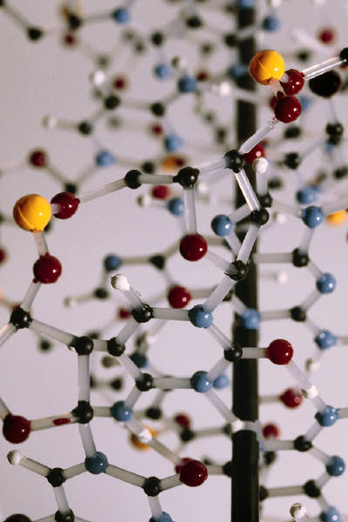
Genetics
For people with one first degree relative with dementia, the average relative risk of getting dementia is 2.6 times greater.
The risk for getting Alzheimer's Disease is 7.5 time greater with two demented relatives.
Alzheimer's Association. (2010)

Slide 37
Genetics
First degree relatives of patients with Alzheimer's disease is linked, in some families, to chromosome 21.
Most of the people with Down's syndrome develop the pathology of Alzheimer's disease.
Mismatches between chrosomes 21 ,14, and 1 are rare and cause early onset dementia.
Alzheimer's Association. (2010)

Slide 38
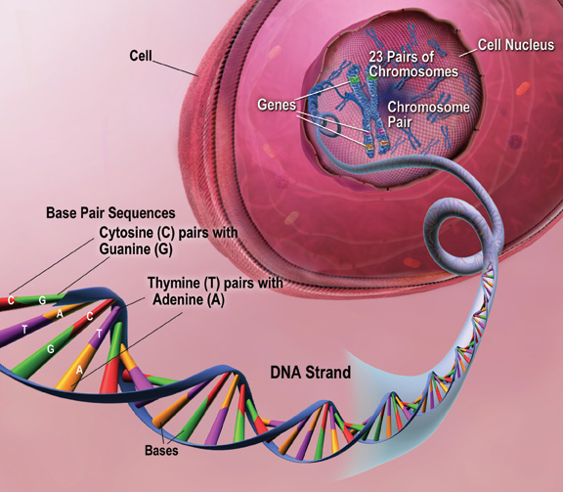
.
Chromosome 19 is involved in making a protein that helps to carry cholesterol in the blood.
The ApoE gene is involved in increasing the risk for women.
National Institute on Aging. (2010)
National Institute on Aging. (2010)

Slide 39

Stress
Stress is a life saving defense reaction. If sustained it becomes maladaptive and injurious to the systems affected.
Stress is regulated by the Hypothalamic-pituitary-adrenal (HPA) system and increases the production of stress hormone - Cortisol.
Aging and repeated exposure to stress are associated with loss of HPA function.
Porth, C. M., & Matfin, G. (2009 )

Slide 40
Stress
Sustained levels of cortisol results in multiple changes, including accelerated expression of brain aging and dementia.
Studies have shown that chronic exposure to stress increases levels of cortisol but also accelerates a decline in cognitive function.
The hippocampus is very vulnerable to the effects of stress.
  Glucocorticoids are located in the hippocampus.
  Glucocorticoids promote the loss of hippocampal neurons by promoting ischemic injury and oxidative stress.
  This is done by increased mitochondrial production of oxidants and reduction of anti-oxidant enzymes.
Porth, C. M., & Matfin, G. (2009 )

Slide 41
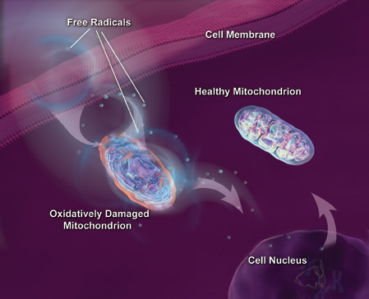
A healthy versus a diseased mitochondria.
National Institute on Aging. (2010)

Slide 42

Inflammation
Microglia cells are associated with inflammation and are present in plaques of Alzheimer patients.
When activated microglia express a variety of receptors involved in the inflammation process.
Pro-inflammatory cytokines increase expression of B-amyloid which leads to more inflammatory processes.
Querfurth, H. W., & Lafera, F. M. (2010)

Slide 43

Inflammation
The brain can be very vulnerable since neurons do not divide; once lost they can’t be replaced.
It has been hypothesized that inflammation contributes heavily to progressive neuronal death.
Inflammation may contribute to the pathogenesis of the disease.
Querfurth, H. W., & Lafera, F. M. (2010).

Slide 44
Memory Jogger
Other factors can impact the course of Alzheimer's disease.
What are the other factors?
  Stress
  Aging
  Inflammation
  Genetics

Slide 45
Nursing Implications
  Patients with dementia are at risk for:
    Falls
    Injury
    Pressure ulcers
    Urinary tract infections
    Catheter related blood stream infections
    Pain

Slide 46
Nursing assessments should include:
  Patients’ nutritional status
  Social engagement patterns
  Pain levels and how they express pain
  Risk for falls / injury
  Risk for wandering
  Family support
  Use of an objective tool to measure cognition (i.e. Mini Mental Exam)
American Psychiatric Association (2007)

Slide 47
Nursing Interventions
Perform holistic assessment.
Observe for other factors which could impact disease process.
Prevent injury / falls.
Involve family.
Provide respite for family if needed.
Educate family and staff caring for patients with dementia.
American Psychiatric Association (2007)

Slide 48
For more information on Alzheimer’s and Dementia:
National Institute on Health and Aging:
http://www.niapublications.org/adearorder
http://www.alz.org/alzheimers_disease_facts_figures.asp
Alzheimer's and genetics: http://www.genome.gov/20019530

Slide 49

Case Study
Mr. Jones is an 80 year old veteran. He is married with two daughters who live near by. His wife is in good health.
  He has a history of:
    Hypertension, diabetes, and is a smoker
    He is progressively confused
    Often gets lost driving
    Wife brought him to hospital
    Brother had Alzheimer's
    Had a high stress job before retirement

Slide 50

Case Study
Answer True or false
Nursing assessments should include a objective tool for cognition measurement.
Mr. Jones is at risk for wandering.
true
false
true
false

Slide 51
References
Alzheimer's Association. (2010, April 1). What is Alzheimer's. Retrieved May 5, 2010, from alz.org: http://www.alz.org/index.asp
American Psychiatric Association. (2000). Diagnostic and statistical manual of mental disorders. Washington, D. C.: American Psychiatric Association.
Kohlman, V. C., Lindsey, A. M., & West, C. M. (2003). Pathophysiological phenomena in nursing human responses to illness. St. Louis, Missouri: Saunders.
National Institute on Aging. (2010, May 3). Alzheimer's Disease Education and Referral Center. Retrieved May 5, 2010, from Alzheimer's Disease; Unraveling the mystery: http://www.nia.nih.gov/Alzheimers
Porth, C. M., & Matfin, G. (2009). Pathophysiology concepts of altered health states (8th ed.). Philadelphia: Lippincott Williams & Wilkins.
Querfurth, H. W., & Lafera, F. M. (2010). Mechanisms of Alzheimer's disease. New England Journal of Medicine , 362 (32), 329-344.

